Slide 1

CSI 120 Week 9
Lecture Notes

Slide 2
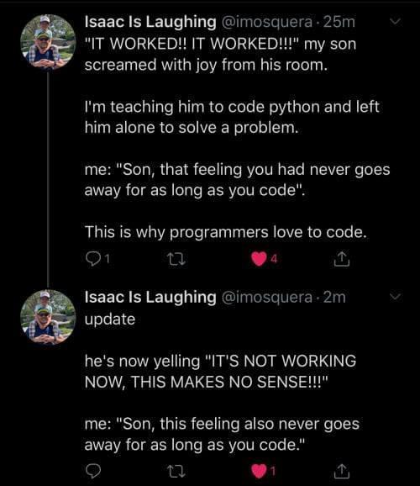

Slide 3
Methods
A method is a way of separating a block of code out into a re-usable task
Methods can be used so that the programmer does not have to repeat themselves
We have used many methods already
Some methods have a RETURN (information sent back to the programmer) and some do not
Some methods have PARAMETERS (information the method needs in order to work) and some do not

Slide 4
Calling a method
When calling a method, you type the name of the method and supply the method with any information or PARAMETERS it needs to work.
If the method has a RETURN (information sent back to the programmer) then we need to capture that return in a variable
Variable that will store the return (information that comes back from the method)
Method Call
Data sent to the method (Parameters) so it can work

Slide 5
Methods we have been calling
Console.Writeline(“Hello World”);
int x = int.Parse(“5”);
String input = Console.ReadLine();
int randomNumber = rand.Next(100);
Parameter
No Return
Parameter
Returns an int
No Parameter
Returns a string
Parameter
Returns an int

Slide 6
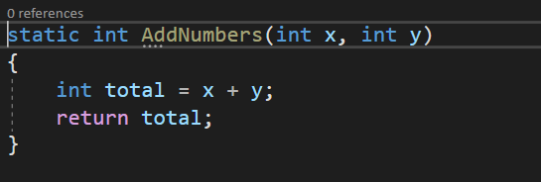
Defining a method
Methods use the following syntax:
static ReturnType NameOfMethod (Parameters if any)
{
//Code that runs when the method is called
}
This entire first line is called
the method signature

Slide 7
Defining a method continued
When a method has a return type you MUST RETURN a value of that type from the method. The value you return MUST match the value defined signature.
Return Type
Return Statement

Slide 8
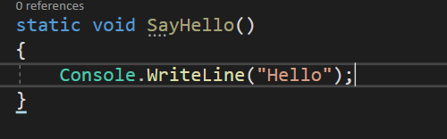
Void Methods
A Method with a return type of void does not give any data back to the programmer.
The void method simply runs and the code within is executed
Example of a method with no return
Display methods (methods that send information to the user) are almost always Void Methods

Slide 9

Calling a void method
Calling a method with no return
Notice that no variable is created
A void method does not give anything back.

Slide 10
Method Returns
When declaring a method, you must determine what the return will be from the method.
The return could be any of the data types we have discussed (int, double, string, etc…)
If a method does not return anything then the return type is void.
A RETURN is information sent back to the programmer.
These data types MUST match

Slide 11

Method Parameters
Method parameters define the information that a method needs to complete the calculation
The parameters act like empty containers that will store values passed to them
The data types of the information given to the method when it is called must match the data type of the parameters.
Here num1 will be 10, num2 will be 2, num3 will be 5

Slide 12
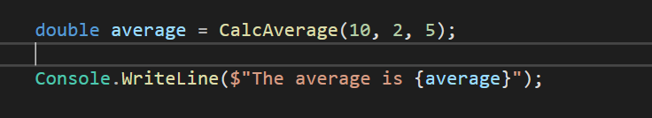
Return Point
When calling a method, the system needs to know where the program should return after the method ends
The system saves the memory address of the location called return point to which it should return
The system jumps to the method and executes the statements in its body
When the method ends, the system jumps back to the return point and resumes execution
When a method has completed all that remains is the return.
Return Point is created here. When this method call is completed all that will remain is the VALUE of the return

Slide 13
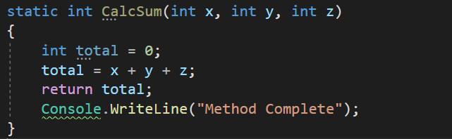
The Return Statement
The return statement immediately ends the method.
The value is sent back to the RETURN POINT and no other code in the method will be executed
All methods that have a return type defined MUST have a return statement
This code is after the return statement and will not run. The return statement immediately jumps back to the return point. Any code after it will not run.

